Slide 1
Designing and Implementing Distributed, Service Based Architecture
.

Slide 2

Course Objectives
In this course we will:
Examine the challenges of distributed systems
Identify the suitability of Microservices
Apply design patterns to Microservice architecture
Evaluate NoSQL database models
Simplify service deployment with containerisation
Explore server less services
2

Slide 3
About You
Your name
Your Job
Your expectations for the course

Slide 4
Chapter 1: The State of Systems

Slide 5
Session Objectives
In this session we will examine
The challenges of monolithic applications
The limitations of an 'n' tier model
5

Slide 6
In the Past …
Most systems were built around monolithic codebases
Even if accessed by network protocols
This was seen as a way of working to improve re-use
And share a standard skillset
Or at least that was the logic
Many systems are still built this way
But, what happens when demand gets high?
Copyright KPL KnowledgeSolutions Ltd – All rights reserved

Slide 7
Copyright KPL KnowledgeSolutions Ltd – All rights reserved

Slide 8
Is it Really a Monolith?
In today's systems you will rarely see a total monolith
Usually broken into several tiers
The standard split is by perceived functionality
Presentation– or more accurately, gateway
Business logic
Data, or enterprise resources.
Copyright KPL KnowledgeSolutions Ltd – All rights reserved

Slide 9
Copyright KPL KnowledgeSolutions Ltd – All rights reserved

Slide 10
Why Are These Tiers Used?
We think of this split of tiers as being logical
Partly because "It's always been done this way"
Where "…always…' is a relative term ☺
At least part of the reason for this split is Conway's Law
"Any organisation that designs a system (defined more broadly here than just information systems) will inevitably produce a design whose structure is a copy of the organisation's communication structure."
Copyright KPL KnowledgeSolutions Ltd – All rights reserved

Slide 11
Copyright KPL KnowledgeSolutions Ltd – All rights reserved

Slide 12

N-Tier Does Not Always Help
What advantages does n-tier aim to give?
What problems does it often create?
Doesn't that mean we are nearly back at the true monolith?
Copyright KPL KnowledgeSolutions Ltd – All rights reserved
Notes:
Separation of changes in one layer from another.
Makes changes easier
May support physical distribution
Problems:
Inflexible
Boundaries defined by technical issues – not business ones
Is an n-tier solution a monolith in disguise? – Partly – but what if we allowed access to the tiers?

Slide 13
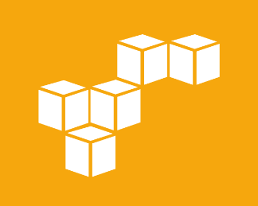
What We Really Really Want
A solution that
Scales easily without an upper bound
Maps directly to the business needs
Is quick and easy to develop
Is simple to evolve
Microservices are part of the solution
BUT not a silver bullet
Copyright KPL KnowledgeSolutions Ltd – All rights reserved

Slide 14
Session Summary
In this session we examined
The challenges of monolithic applications
The limitations of an 'n' tier model
14

Slide 15
Chapter 2: Brewer's Theorem

Slide 16
Session Objectives
In this session we will examine
The challenges created by highly distributed system
Brewer's theorem
16

Slide 17
The Problem of Internet Shopping
You need a book for your holiday.
You spot 'Of Mice and Men' on a well known retail store site
You order it
You check out…
Well of course you actually don't as you spot other items
It's the nature of internet shopping to never buy one thing
Into the basket goes sun cream, sunglasses and so on
While you are flicking around between glasses designs…
Someone else buys the last copy of 'Of Mice and Men'
They go straight to check out

Slide 18

Poor Shoppers
What are the potential issues?
Notes:
Stock levels – when do we commit
Don't want to loose a sale to an abandoned cart
Could apply a temporary lock
What about distributed systems
Which nodes get the lock?
What happens if the nodes can't communicate?

Slide 19
Brewer's Theorem
Brewer's, or the CAP, theorem
States there are 3 core requirements in a distributed system
And that these exist in a special relationship
Consistency – data read from any node will be the most recent
Availability – nodes will be available
Partition Tolerance – system works even if nodes are isolated
The "special relationship"
You can only meet 2 of the 3 requirements in any system!

Slide 20
What Do We Mean By C. A. P.?
Consistency
Our system operates totally, successfully, or not at all.
In reality we cannot have multiple values for the same piece of data.
Availability
Self explanatory, the service is available for interaction.
No messages about 'Please wait‘.
Sadly, the busier a service gets, the likelier availability problems.
Partition Tolerance
The ability to cope with network loss between interacting nodes.
More common since the web age.

Slide 21
Addressing Brewer's Issues -P
Drop the need for Partition Tolerance
Means you have avoid partitions happening
So design with no ability to partition
For a given transaction, everything on one machine
Issues with scaling!

Slide 22
Addressing Brewer's Issues - A
Drop the need for Availability
Means you have to be prepared to wait
If a partition occurs everything waits until data is consistent again
Services remain unavailable during this time
Logistical problems in bringing back availability gracefully.

Slide 23
Addressing Brewer's Issues - C
Drop the need for Consistency
Means you have to be prepared for inconsistency
Accept that everything will become 'Eventually Consistent'
May mean business problems in notifying 'customers'
Order goes to back order?
Think of Facebook or Twitter
All posts / tweets arrive to all users
Eventually!

Slide 24
Addressing Brewer's Issues - Web
We can't avoid Partition Tolerance
The nature of the infrastructure means it may occur
We can only have two from CAP according to Brewer's
Hence we now have to decide on Availability or Consistency
Which would you go for?
Why?

Slide 25
Brewer's Theorem
Draw a series of diagrams that show how Brewer's theorem is manifested in a standard web based application. It is likely that your diagram will need to include various nodes – probably more than one of each - and network portions.

Slide 26
Session Summary
In this session we examined:
The challenges created by highly distributed system
Brewer's theorem
26

Slide 27
Chapter 3: Microservices Basics

Slide 28
Session Objectives
In this session we will examine
The benefits of microservices
Microservice design principles
The impact of network performance on microservices
Development and deployment management
28

Slide 29
Microservice Basics
Why Microservices
Microservice Principles
Network Performance
Selecting Services
Building and Managing Services

Slide 30
What Are Microservices?
"Small, independently releasable, autonomous services that work together modelled around a business domain"
- Thoughtworks
Copyright KPL KnowledgeSolutions Ltd – All rights reserved

Slide 31
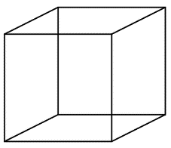
The Scale Cube
Describes options for improving performance in a distributed system
Y – Functional Decomposition
Z Data Partioning
X – Horizontal Duplication
Copyright KPL KnowledgeSolutions Ltd – All rights reserved

Slide 32
The Scale Cube
Horizontal Duplication
Keep adding more machines
Behind a load balancer
All instances potentially access all the data
Data Partioning
Each server responsible for access to a subset of data
Functional Decomposition
Break the system up into services
Which can then be multiply deployed
Microservices
Copyright KPL KnowledgeSolutions Ltd – All rights reserved

Slide 33
Why Microservices?
In essence microservices are simply opinionated SOA
The style of service as well as message protocols are defined
The big gain is choices of how you build a system
Now or in the future
A toolbox of Lego bricks, each self-contained
The price is complexity of your system
Particularly when tracing messages through system
Copyright KPL KnowledgeSolutions Ltd – All rights reserved

Slide 34
Applications are Composed from Microservices
Well designed services may form part of multiple applications
Application 1
Application 2
Copyright KPL KnowledgeSolutions Ltd – All rights reserved

Slide 35
Should you use Microservices?
Microservices are not a sliver bullet
Flexibility and resilience increase
So does complexity
Can you answer this question?
What is the end goal for the application?
The one that makes the added complexity worthwhile
Flexibility?
New systems needed where you don't yet know you will need?
Copyright KPL KnowledgeSolutions Ltd – All rights reserved

Slide 36
Benefits of Microservices
Small
Easier for developers to understand and test
Less bottle necks with development environments
Rapid startup
Independently deployable
Scalable development
Multiple teams build multiple services
Improved fault isolation
Single failing service should not cause the entire application to fail
Flexibility to build different parts of an application with different tool-sets
Copyright KPL KnowledgeSolutions Ltd – All rights reserved

Slide 37
Disadvantages of Microservices
Tool support for Microservices usually inferior to traditional development
Testing is more difficult
Service communication is an additional overhead
Additional challenges where use-cases span multiple services
Coordination between teams
Ensuring one service does not break another
Distributed transactions
Copyright KPL KnowledgeSolutions Ltd – All rights reserved

Slide 38
Disadvantages of Microservices
Complex deployment
Multiple services on multiple platforms must all be deployed correctly
Increased resource utilisation
Copyright KPL KnowledgeSolutions Ltd – All rights reserved

Slide 39
Microservice Basics
Why Microservices
Microservice Principles
Network Performance
Selecting Services
Building and Managing Services
Copyright KPL KnowledgeSolutions Ltd – All rights reserved

Slide 40
Microservice Principles
The following slide shows a selection of principles
These should be adhered to when creating microservices
Can you come up with a reason for each?
Can you think of any others?
Copyright KPL KnowledgeSolutions Ltd – All rights reserved

Slide 41
Microservice Principles to Consider
Copyright KPL KnowledgeSolutions Ltd – All rights reserved

Slide 42
Principles – Our Answer
Isolating Failures
Microservices should each run on their own machine
Physical server
Virtual machine
Container
If the service fails
It should not break others
User First
Service design should be driven for how the service will be used
Not how it will be implemented
Copyright KPL KnowledgeSolutions Ltd – All rights reserved

Slide 43
Principles – Our Answer
Hide details of implementation
Consumers should only know how to interact with a service
Not how it is implemented
Automation
Wherever possible services should be deployed and operate without manual intervention
Model Business Domain
The closer services are to the business they are related to the more likely they are to work
Independently Deployable
Services should be loosely coupled so that they can be deployed individually without breaking the system
Copyright KPL KnowledgeSolutions Ltd – All rights reserved

Slide 44
Principles – Our Answer
Services should be observable or traceable
How else do we know what's happening?
Copyright KPL KnowledgeSolutions Ltd – All rights reserved

Slide 45
How Big is a Microservice
Consider a retail web application
We could choose to implement "everything" as a microservice
Services
UI Builder
Cart Manager
Inventory
Orders
Accounts
Authentication
Search
Session Management
…
That's a lot of services do they all make sense?
Maybe we should make every class a microservice!
Copyright KPL KnowledgeSolutions Ltd – All rights reserved

Slide 46
How Big is a Microservice
Choosing services correctly is a challenge
Trading advantages and disadvantages
Two scenarios
Breaking up an existing monolithic application
To allow scaling
Building a new application
To provide flexibility and scalability if we need it!
Need to choose appropriate service boundaries
Uncle Bob's Single Responsibility Principle is a good start
Copyright KPL KnowledgeSolutions Ltd – All rights reserved

Slide 47
Decomposing Applications into Services
Many different approaches
Domain driven design
Service per sub-domain
Decompose by business function
Service per function
Decompose by entity
Spot the noun and create a service to manage each entity
The different approaches often drive out similar services
Copyright KPL KnowledgeSolutions Ltd – All rights reserved

Slide 48
So: How Big is a Microservice
A confession: there is no right answer!
We need the Goldilocks solution!
A good starting point is
One business function = one service
One service = one business function
Copyright KPL KnowledgeSolutions Ltd – All rights reserved

Slide 49
Microservice Basics
Why Microservices
Microservice Principles
Network Performance
Selecting Services
Building and Managing Services
Copyright KPL KnowledgeSolutions Ltd – All rights reserved

Slide 50

Microservices and Network Performance
How does network performance effect microservice performance?
Should we worry?
Copyright KPL KnowledgeSolutions Ltd – All rights reserved

Slide 51
Virtualised Networks
Consider the case where each microservice runs in a separate virtual machine
Is this how network traffic flows?
VM
VM
Host
Network
Copyright KPL KnowledgeSolutions Ltd – All rights reserved

Slide 52
Virtualised Networks
Or is it this?
Communication between virtual machines is not limited by network performance
VM
VM
Host
Network
Copyright KPL KnowledgeSolutions Ltd – All rights reserved

Slide 53

Software Defined Networks
Cloud providers virtualise almost all network infrastructure
Allows network configurations to be defined by software
On demand
An additional benefit is performance
Virtual networks are usually massively faster than physical ones
But: any microservice will be slower than invoking local code
Copyright KPL KnowledgeSolutions Ltd – All rights reserved

Slide 54
Microservice Basics
Why Microservices
Microservice Principles
Network Performance
Selecting Services
Building and Managing Services
Copyright KPL KnowledgeSolutions Ltd – All rights reserved

Slide 55
Identifying Microservices
Greatest benefits are achieved when services form part of an architecture
Should be well understood
Should align with the business needs
Creating a service architecture requires a process
The process should
Encourage re-use of existing services
Identify new services
Which align with the business needs
Copyright KPL KnowledgeSolutions Ltd – All rights reserved

Slide 56
A Process – Quick Sketch
Define a domain / context boundary
Limits as to what to include in a project
If decomposing an existing system
Examine the resources / entities being managed
These become candidate services
For a new microservice based solution
Examine "user" stories for nouns
These become candidate services
Validate candidate services against the way the entities might be managed in the 'real-World'
Ask yourself – is this useful as a service?
Copyright KPL KnowledgeSolutions Ltd – All rights reserved

Slide 57
Identifying Microservices - Example
Consider our retail web application
We might start with user stories
As a user I want to browse for products
As a user I want to see recommendations from others
As a user I want to be able to buy things
As an admin I want to see what has been ordered
We can cheat a little here as we all know what a retail web app looks like
We need UI's for
Catalogue display, checkout, order management
Copyright KPL KnowledgeSolutions Ltd – All rights reserved

Slide 58
Identifying Microservices - Example
As we expand the user stories and examine the interactions with the UI's we discover
The catalogue UI needs a list of items in the catalogue and a list of user recommendations
The checkout UI needs access to product details in the catalogue and has to be able to raise orders
Using a 'spot the noun' technique yields
Catalogue service, recommendations service and an orders service
Perhaps a user service?
Copyright KPL KnowledgeSolutions Ltd – All rights reserved

Slide 59

Identifying Microservices - Example
Candidate services so far:
Catalogue
Recommendations
Orders
User
Validating the list
All good except perhaps the user service
Examine other user stories to see if we need to manage users
git clone https://mikejrway@bitbucket.org/mikejrway/bbc_micro_services_load.git
Exercise Manual ./PPTX/Exercises.html
Notes:
Exercise: Define a set of services

Slide 60
Microservice Basics
Why Microservices
Microservice Principles
Network Performance
Selecting Services
Building and Managing Services
Copyright KPL KnowledgeSolutions Ltd – All rights reserved

Slide 61
Implications for Microservice Teams
Our microservice principles included
Independently releasable and autonomous…
Aligned with the needs of the business
Remember Conway's Law?
What is the implication of this on microservice development teams?

Slide 62

Make Up and Size of Team
Successful microservices are built with teams who
Design the service
Build the service
Deploy the service
Operate the service
Microservice teams need all these skills
How big is the team?
Varies ☺
Amazon have famous 'two pizza' teams
Team members with specific skills may be members of multiple teams

Slide 63
The Devops Pipeline
Microservices are commonly deployed using Continuous Delivery
Getting features to users quickly and efficiently
The develop / build / test / deploy workflow
Known as the pipeline
Should be automated
Ensures consistency
Avoids human errors
Makes it viable to make small (incremental) changes to a service
Copyright KPL KnowledgeSolutions Ltd – All rights reserved

Slide 64

An Ideal Pipeline
Each time source code is checked in
Build happens automatically
Tests run
Code is deployed to a staging server
Change is approved
Code is deployed to production server
Only the code submission and approval should require human interaction
Only the code submission and approval should require human interaction
Code submitted to repository
Build
Test
Deploy to Staging
Deploy to Production
Copyright KPL KnowledgeSolutions Ltd – All rights reserved

Slide 65
Pipeline Tools
The pipeline is typically implemented with a mix of tools
Source repository – Git
Build tools – Maven, Gradle, NPM
Unit Testing – JUnit, NUnit, Jasmine
Unit tests often integrated with the build tool
Integration testing – Jenkins, Travis
Deployment – Chef / Puppet
List of specific tools is not exhaustive!
Copyright KPL KnowledgeSolutions Ltd – All rights reserved

Slide 66
Automating the Pipeline
Pipeline steps should be integrated
New feature moves smoothly from one step in the pipeline to the next
Human interaction only required at approval stages
Or if something fails!
Pipelines can be automated with
Scripts (Bash, PowerShell…)
Build tools such as Maven or Gradle
Specialist pipeline management tools
AWS CodePipeline
Copyright KPL KnowledgeSolutions Ltd – All rights reserved

Slide 67
Session Summary
In this session we have examined
The benefits of microservices
Microservice design principles
The impact of network performance on microservices
Development and deployment management
Copyright KPL KnowledgeSolutions Ltd – All rights reserved
67

Slide 68
Chapter 4: Service Interfaces

Slide 69
Session Objectives
In this session we will examine
The need for service interfaces
The Swagger tools
Copyright KPL KnowledgeSolutions Ltd – All rights reserved
69

Slide 70
Service Interfaces
Accessing Services
Swagger / OpenAPI
Copyright KPL KnowledgeSolutions Ltd – All rights reserved

Slide 71

Accessing Services
Services are accessed by messages
Typically
A message is sent to a service
Which does its work
Responds with a message
Copyright KPL KnowledgeSolutions Ltd – All rights reserved

Slide 72
Defining Interfaces
Services need well-defined interfaces
So clients can create the correct messages
Ideally, tools should be able to generate code from the interface definition
Several competing languages to define interfaces
RAML – raml.org
Swagger / OpenAPI – swagger.io / https://www.openapis.org/
JSONDoc – jsondoc.org
RAML and Swagger both have tools for generating client and server code
Copyright KPL KnowledgeSolutions Ltd – All rights reserved

Slide 73
GET, POST, PUT, DELETE or PATCH
(source restcookbook.com)
GET is used to retrieve a resource
DELETE is used to delete (or perhaps archive) a resource
PUT is used when you can update a resource completely through a specific resource
POST is used when adding or updating a resource when you do not have a location (resource identifier) for the new resource
PATCH is used to perform an update on part of a resource
Copyright KPL KnowledgeSolutions Ltd – All rights reserved

Slide 74
Service Interfaces
Accessing Services
Swagger / OpenAPI
Copyright KPL KnowledgeSolutions Ltd – All rights reserved

Slide 75
Swagger / OpenAPI
Swagger consists of
The OpenAPI specification - http://swagger.io/specification/
An editor
Online or download an install locally
The Swagger UI tool
Allows interaction with a service defined by the OpenAPI
CodeGen
Generates service skeletons and client code from a OpenAPI definition
Tools exist on some platforms to create an OpenAPI specification from code
Java - JAXRS Analyzer maven plugin
Copyright KPL KnowledgeSolutions Ltd – All rights reserved

Slide 76
Sample OpenAPI Document
swagger: "2.0"
info:
title: Sample API Document
description: API description in Markdown.
version: 1.0.0
host: api.example.com
basePath: /v1
schemes:
- https
paths:
/users:
get:
summary: Returns a list of users.
description: Optional extended description in Markdown.
produces:
- application/json
responses:
200:
description: OK
It's YAML
Copyright KPL KnowledgeSolutions Ltd – All rights reserved

Slide 77
YAML – Yet Another Markup Language
A superset of JSON
Whitespace indentation denotes structure (nesting)
But no tabs!
Comments start with #
Properties (associative arrays)
Name: value (that's colon space)
Lists start with a – then one member per line
Or comma separated list surrounded with []
Nice 'cheat sheet' - http://cheat.readthedocs.io/en/latest/yaml.html
Copyright KPL KnowledgeSolutions Ltd – All rights reserved

Slide 78
OpenAPI Schema Types
OpenAPI allows definitions of reusable types
Using YAML version of JSON Schema
post:
parameters:
- name: pet
in: body
description: Details of pet to add
schema:
$ref: '#/definitions/Pet'
required: true
responses:
200:
description: Make a new pet
Copyright KPL KnowledgeSolutions Ltd – All rights reserved

Slide 79
JSON Schema Definition
Object type definitions specify names and types of properties in an object
definitions:
Pet:
type: object
properties:
name:
type: string
birthday:
type: integer
format: int32
Copyright KPL KnowledgeSolutions Ltd – All rights reserved

Slide 80
Swagger Demo
The demo will show examples of using the Swagger tool for creating, documenting and distributing microservice style apis
Copyright KPL KnowledgeSolutions Ltd – All rights reserved
Notes:
Exercise: You are required to create some appropriate Swagger based apis for the accounts and delivery services from the retail system.

Slide 81
Session Summary
In this session we have examined
The need for service interfaces
The Swagger tools
Copyright KPL KnowledgeSolutions Ltd – All rights reserved
81

Slide 82
Chapter 5: Deployment Options

Slide 83
Session Objectives
In this session we will examine
The requirements for microservice deployment
Public and private cloud provision
Containerisation
Copyright KPL KnowledgeSolutions Ltd – All rights reserved
83

Slide 84
Deployment Options
Microservice Deployment Requirements
Cloud Computing
Containerisation
Copyright KPL KnowledgeSolutions Ltd – All rights reserved

Slide 85
Deploying Microservices
Full benefit of microservices requires a scalable environment
The ability to easily modify the number of service instances
As load varies
Options
Virtualized deployment onto conventional server infrastructure
Cloud
Public
Private
Containerisation
A combination of the above
Copyright KPL KnowledgeSolutions Ltd – All rights reserved

Slide 86

Limitations of Conventional Infrastructure
Virtualisation of microservices
One service per virtual machine
Provides reliability and security
Scaling requires starting additional virtual machines
Relatively slow
What happens when you run out of physical servers?
Copyright KPL KnowledgeSolutions Ltd – All rights reserved

Slide 87
Deployment Options
Microservice Deployment Requirements
Cloud Computing
Containerisation
Copyright KPL KnowledgeSolutions Ltd – All rights reserved

Slide 88
Cloud Computing
Cloud provides access to a potentially huge pool of resource
Provision what you want when you want it
Pay only for what you use
"the practice of using a network of remote servers hosted on the Internet to store,
manage, and process data, rather than a local server or a personal computer."
Google search result 5/5/17
Copyright KPL KnowledgeSolutions Ltd – All rights reserved

Slide 89
Amazon AWS
An example of a Cloud computing provider
The first and (probably) biggest provider
Other providers have similar offerings
Microsoft Cloud (Azure)
Google Cloud Platform
Rackspace
See www.cloudharmony.com for a comparative list of providers
A huge range of services
Initially simple infrastructure
Virtual machines in the Cloud
Copyright KPL KnowledgeSolutions Ltd – All rights reserved
89

Slide 90
AWS – Sample Services
Compute
Virtual machines, auto-scaling, load-balancing
Storage
Blob storage, tape archiving, network mountable file systems
Database
Managed RDBMS, NoSQL
Networking
Software defined networking, DNS, content delivery
Management
Monitoring, alarms
Analytics
Big data tools
Copyright KPL KnowledgeSolutions Ltd – All rights reserved
90

Slide 91
AWS – IaaS Machines
Core of AWS is Infrastructure as a Service
Virtual machines in the cloud
AMI – Amazon Machine Image
A template for a virtual machine
Provided by Amazon or by you
Instance – A running virtual machine
Machine Image
Instance
Copyright KPL KnowledgeSolutions Ltd – All rights reserved
91

Slide 92
Regions and Zones
AWS Data Centres are distributed around the world
Each known as a Region
Each Region has multiple Availability Zones
Groups of machines with no common point of failure
AZ-1
AZ-2
AZ-3
Region
Copyright KPL KnowledgeSolutions Ltd – All rights reserved
92

Slide 93

AWS Networking
Instances run within a Virtual Private Cloud
A network configuration
May not be private!
Contains one or more subnets
Each subnet is associated with an Availability Zone
Network access to instances is controlled by Security Groups
Controls which ports ingress and egress is permitted on
Instance
Security Group
VPC
Copyright KPL KnowledgeSolutions Ltd – All rights reserved
93

Slide 94
Auto Scaling
Adding and removing instances
As load varies
AWS provides an auto-scaling group
Defines the minimum, maximum and desired number of instances
Instance number may be modified
On a time schedule
In response to instance monitoring
Cloud Watch
Load is shared across instances with a load balancer
Copyright KPL KnowledgeSolutions Ltd – All rights reserved
94

Slide 95
AWS Load Balancing
Instances started by auto-scaling may be associated with a load balancer
Distributes requests to running instances
Monitors for failed instances
Load Balancer
AZ1
AZ2
Auto-Scaling Group
Copyright KPL KnowledgeSolutions Ltd – All rights reserved
95

Slide 96
AWS Demonstration
Your instructor will demonstrate some of the capabilities of AWS
Including
Provisioning a virtual machine
Auto scaling
Copyright KPL KnowledgeSolutions Ltd – All rights reserved
96
Notes:
Start a server with Apache HTTPD and PHP
Web page with IP
Create an image from it
Deploy as ASG
Associate load balancer

Slide 97
Deployment Options
Microservice Deployment Requirements
Cloud Computing
Containerisation
Copyright KPL KnowledgeSolutions Ltd – All rights reserved

Slide 98
Docker
Docker is a software containerisation platform
A container is a complete filesystem which contains a software application and all of its dependencies
A great choice for microservice deployment
Containers isolate applications from each other and the rest of the system
Similar concept to virtualization except:
Containers do not contain an operating system
Just the application files
All containers share the same OS
Copyright KPL KnowledgeSolutions Ltd – All rights reserved

Slide 99
Containerisation vs. Virtualisation
Container
Container
VM
VM
App
App
App
App
Operating System
Operating System
Docker Container Engine
Hypervisor
Operating System
Operating System
Hardware
Hardware
Copyright KPL KnowledgeSolutions Ltd – All rights reserved
99

Slide 100
Running Docker
Docker was originally a Linux application
It uses the kernel container functionality
We will be running our Docker images on Linux
Windows containers are supported on Windows Server 2016
Important: Unlike virtualization
Linux containers require a linux machine
Windows containers require a Windows machine
Docker can run inside a virtual machine
Copyright KPL KnowledgeSolutions Ltd – All rights reserved

Slide 101
Images and Containers
Docker containers are like directory structures
A container holds everything required for an application to run
Every container is created from a Docker image
They can be run, started, stopped and deleted
Docker images are read-only templates
Created from snapshots of containers
Used to create new running containers

Slide 102
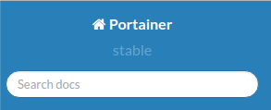
Managing Docker
All aspects of Docker can be run through the command line
Powerful but tedious to learn
A nice alternative
Portainer a web interface for Docker
Allows graphical management of many aspects of Docker
Run it in a Docker container
Connect to port 9000 with a browser
sudo docker run -d -p 9000:9000
-v /var/run/docker.sock:/var/run/docker.sock portainer/portainer
Copyright KPL KnowledgeSolutions Ltd – All rights reserved
102

Slide 103
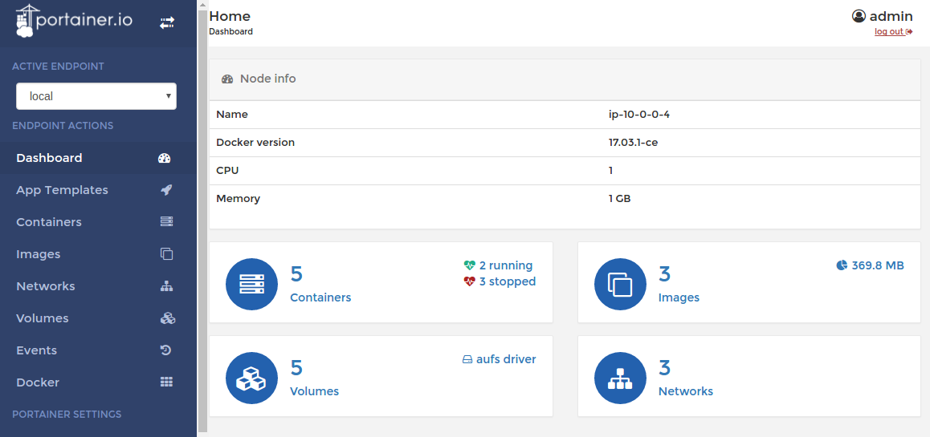
Portainer
Copyright KPL KnowledgeSolutions Ltd – All rights reserved
103

Slide 104
Docker Demo
Your instructor will demonstrate how to create, run and interact with a Docker machine
Copyright KPL KnowledgeSolutions Ltd – All rights reserved
Notes:
Demo: run the hello world demo docker run hello-world
Then as it says run docker –it Ubuntu bash
Then docker run -d -p 9000:9000 -v /var/run/docker.sock:/var/run/docker.sock portainer/portainer
Show containers and images. Start a new container (Add Container)

Slide 105
Docker Images
Where did the Portainer image come from?
It was pulled from the default Docker registry
Images can be created in two ways
From a customised container
Using the commit command
Using a Dockerfile
The preferred option
Copyright KPL KnowledgeSolutions Ltd – All rights reserved
105

Slide 106
The Dockerfile
Dockerfile defines an image content
Example from https://github.com/kstaken/dockerfile-examples/blob/master/nodejs/Dockerfile
FROM ubuntu
MAINTAINER Kimbro Staken
RUN apt-get install -y software-properties-common python
RUN apt-get update
RUN apt-get install -y nodejs
RUN mkdir /var/www
# Add app.js from local directory to the image
ADD app.js /var/www/app.js
CMD ["/usr/bin/node", "/var/www/app.js"]
Base image
Instructions to run when building the image
Command to execute when the container starts
Copyright KPL KnowledgeSolutions Ltd – All rights reserved
106

Slide 107
Building Images
The Dockerfile should be called dockerfile
In a directory with only files for the image being created
To create the image
docker build –t="image-name" .
To run the image
With a terminal
docker run –it image-name
In the background
docker run –d image-name
Use –name container-name to specify an image name
Or accept the name Docker assigns
Copyright KPL KnowledgeSolutions Ltd – All rights reserved
107

Slide 108

Docker Registry
Docker images can be run from a local machine
Images are shared or made available for production via a registry
Public or private registries can be created at https://cloud.docker.com
Alternatively run a private registry as a Docker container!
docker run -d -p 5000:5000 --restart=always --name registry registry:2
Copyright KPL KnowledgeSolutions Ltd – All rights reserved
108

Slide 109
Using the Registry
Login – if registry requires authentication
Push an image to the registry
Pull an image from the registry
docker login
docker push localhost:5000/myfirstimage
docker push registryname/myfirstimage
docker pull localhost:5000/myfirstimage
docker pull registryname/myfirstimage
Copyright KPL KnowledgeSolutions Ltd – All rights reserved
109
Notes:
Demonstrate pushing an image to the (my) registry
Then an exercise:

Slide 110
Session Summary
In this session we have examined
The requirements for microservice deployment
Public and private cloud provision
Containerisation
Copyright KPL KnowledgeSolutions Ltd – All rights reserved
110

Slide 111
Chapter 6: Microservice Design Patterns

Slide 112
Session Objectives
In this session we will examine
The benefits of design patterns
Some key microservice design patterns
Apply patterns to a conceptual service design
Copyright KPL KnowledgeSolutions Ltd – All rights reserved
112

Slide 113
Microservice Design Patterns
Design Patterns
Proxy
Aggregator
Circuit Breaker
Service Registration
Message Patterns
Data Store Patterns
Copyright KPL KnowledgeSolutions Ltd – All rights reserved

Slide 114
Microservice Design Patterns
Design patterns are common in standard OO style systems
Even more useful in microservices
Many small, full stack services needing to inter operate
Need ability to efficiently bring together
And also to break out if problems occur
Copyright KPL KnowledgeSolutions Ltd – All rights reserved

Slide 115
The Standard Patterns
We'll now work through some standard issues
And define the relevant patterns from first principles
This session is largely demo based
With live coding and group involvement
Copyright KPL KnowledgeSolutions Ltd – All rights reserved

Slide 116
A Set of Tools
We will cover:
Aggregator
Proxy
Circuit Breaker
Database per Service
Shared Data
Asynchronous messaging
Copyright KPL KnowledgeSolutions Ltd – All rights reserved

Slide 117
Microservice Design Patterns
Design Patterns
Proxy
Aggregator
Circuit Breaker
Service Registration
Message Patterns
Data Store Patterns
Copyright KPL KnowledgeSolutions Ltd – All rights reserved

Slide 118
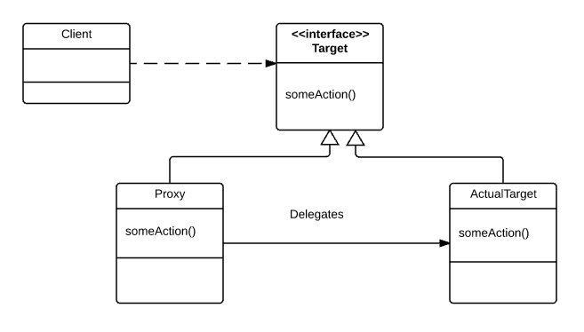
Proxy Pattern
Copyright KPL KnowledgeSolutions Ltd – All rights reserved
118

Slide 119
Proxy Pattern
Proxy is a surrogate or place holder for the actual code being invoked
Extensively used in microservice clients
Client instantiates a proxy
Makes method calls on local proxy
Proxy then creates messages and handles communication with the service
Proxy provides a good place to implement other aspects
Authentication
Logging
Circuit breaker pattern
…
Copyright KPL KnowledgeSolutions Ltd – All rights reserved
119

Slide 120
Microservice Design Patterns
Design Patterns
Proxy
Aggregator
Circuit Breaker
Service Registration
Message Patterns
Data Store Patterns
Copyright KPL KnowledgeSolutions Ltd – All rights reserved

Slide 121
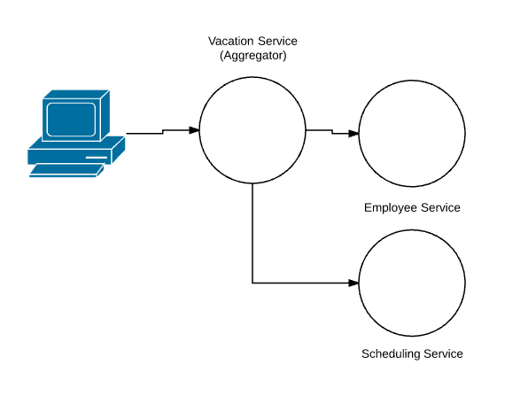
Aggregator Pattern
Copyright KPL KnowledgeSolutions Ltd – All rights reserved
121

Slide 122
Aggregator Pattern
A service (or a service consumer) combines the result of invoking multiple services
Commonly used where a business function needs access to other business data
Anti-Pattern Alert
If the majority of your microservices are aggregators then your services are probably too fine grained
Copyright KPL KnowledgeSolutions Ltd – All rights reserved
122
Notes:
Exercise: Service Aggregation
Deply 3 services (docker)
Examine each one
Generate a new aggregate service
Start the aggregation process
Class completes as exercise….

Slide 123
Microservice Design Patterns
Design Patterns
Proxy
Aggregator
Circuit Breaker
Service Registration
Message Patterns
Data Store Patterns
Copyright KPL KnowledgeSolutions Ltd – All rights reserved

Slide 124
The Need for a Circuit Breaker
All computer systems fail – period!
Consider 99.95% reliability
Roughly 20 minutes / month downtime
If an application depends on 10 services
Could be 2 hours 20 downtime / month
99.7% application uptime
What happens if a failed service causes all requesters to block?
Application server may run out of resource
Potential for failure of all clients – a cascade failure
Cloud computing and microservices
Must protect against failure
Copyright KPL KnowledgeSolutions Ltd – All rights reserved
124

Slide 125
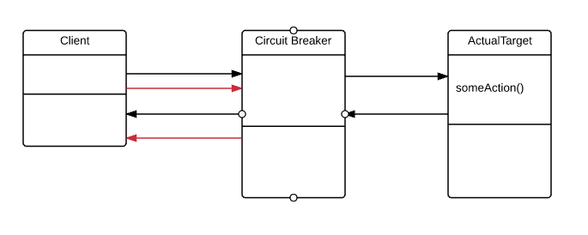
Circuit Breaker
Extends the proxy pattern
Monitors connections
Checks for failed connection attempts and timeouts
Protects from cascade failures
By failing quickly
Copyright KPL KnowledgeSolutions Ltd – All rights reserved
125

Slide 126
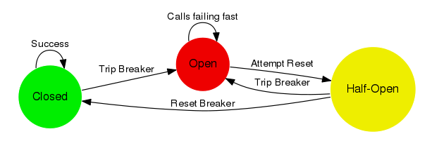
Circuit Breaker Operation
Closed state - normal operation
Calls forwarded to target
Failed calls (timeout or error) increment a counter
Breaker trips when count limit exceeded
Open state
All calls fail fast – goes to half-open when reset period expires
Half open state
First call allowed – trips breaker if it fails
Subsequent calls fail until the reset period expires
126

Slide 127
Circuit Breaker Demonstration
Your instructor will demonstrate the circuit-breaker in action
127
Notes:
/home/mjrw/Documents/BBC-Microservices/Source/nodejs-services
npm install circuitbreaker
run with node circuit-breaker.js

Slide 128
Microservice Design Patterns
Design Patterns
Proxy
Aggregator
Circuit Breaker
Service Registration
Message Patterns
Data Store Patterns

Slide 129
Service Discovery
How do we route traffic to a service?
Might the URL change?
Could there be more that one URL for a service?
So: how do we find services?
129
Notes:
URL + port
Yes – particularly in a Cloud environment
Yes – scaling is a key issue
A service registry

Slide 130
Service Registration Pattern
Services self-register with a central registry
Each registration consists of
Service name – a key
Url and port data for each deployed service
Registry performs load-balancing
Requests for a given service name given each url / port in turn
Registry implementations
Netflix Eureka
Etcd
Consul
Apache Zookeeper
Service 1
Service 2
Service 3
Registration
130

Slide 131
Who Registers a Service?
3rd Party Registration
Deployment / Undeployment process registers / deregisters service
External monitoring detects service failure
Circuit breaker could trigger deregistration on failure
Self Registration
Services register themselves as the are deployed
Must deregister
When undeployed
In the event of failures
Circuit breaker and/or health-checks also deregister a service
131
Notes:
Zookeeper demo

Slide 132
Service Health Check Pattern
Problem
How to detect that a running service instance is unable to handle requests?
Forces
An alert should be generated when a service instance fails
Requests should be routed to working service instances
Solution
A service has an health check API endpoint (e.g. /health) that returns the health of the service.
Checks
Connections to infrastructure (database etc)
Host status – disk space
Application specific logic
132

Slide 133
Service Health Checks
Some registries may be configured to perform health checks
Query each service in turn
Identify "dead" services
No longer return their details
Circuit-breaker can be used to mark a service instance as faulty
Service 1
Service 2
Service 3
133

Slide 134
Microservice Design Patterns
Design Patterns
Proxy
Aggregator
Circuit Breaker
Service Registration
Message Patterns
Data Store Patterns

Slide 135
Messaging Patterns
Two key messaging patterns
Synchronous messaging
Sender sends a message and waits for a response
Typically implemented with REST style messaging
Or even SOAP on SOA style services
Asynchronous messaging
Fire and forget messaging
Message is placed into a queue by the sender
Recipient fetches the message from the queue
The default choice should be synchronous messaging
Simple and effective
135

Slide 136
Asynchronous Messaging
Asynchronous messaging should be used
When the service being invoked is long-running
And it's not appropriate for the client to block and wait
When a message needs to be distributed to multiple receivers
Can you think of any other cases?
136

Slide 137
Implementing Asynchronous Messaging
Requires a message queue technology
RabbitMQ and Kafka are good examples
Kafka is more complex to use but a single instance can handle 100000's of thousands of requests per second
Kafka can easily scale to handle millions of requests per second
AWS and Azure offer Cloud based message queues
Consumer
Message Queue
Consumer
Producer
137

Slide 138
Asynchronous Messaging Operation
Message producer adds a message to a queue
Normally to a "topic"
Consumers subscribe to the topic
Either poll the queue or are notified of a message arrival
Consumers pull the message from the queue
May then remove message – or leave for other consumers
138
Notes:
NodeJS client to Aws SQS

Slide 139
Microservice Design Patterns
Design Patterns
Proxy
Aggregator
Circuit Breaker
Service Registration
Message Patterns
Data Store Patterns

Slide 140
Database per Service
Forces
Services must be loosely coupled
Some transactions must interact with data from multiple services
RDBMS is complex to scale
Different services may have different storage requirements
Solution
Keep data for a service private to that service
Service 1
Service 2
140

Slide 141
Issues with Database per Service
Transactions across multiple services are difficult
Think CAP
Joins are challenging
Solutions:
Application join – applications queries multiple services and builds a view
Command Query Responsibility Segregation (CQRS)
Create a service responsible for generating the view
Maintains it's own copy of the view data
Service subscribes to other services to keep data synchronized
Increased complexity of multiple databases
141

Slide 142
Shared Database
Services all share a single database
Benefits
Use of ACID transactions
Single database to manage
Issues
Increased coupling
Developers must coordinate with other teams
Potential for issues with cross-service record locking
Service 1
Service 2
142

Slide 143
Data Synchronisation
The Database / service model is usually preferred
But it creates a major issue
How to synchronise data across multiple services
And multiple types of service
143

Slide 144
The Synchronisation Challenge
Consider a membership service
Supports actions
Add a member
Query members
Service is deployed many times
If each service has it's own data store
How do we ensure that the list operation returns a newly added member?
If the methods are invoked on different instances
Add
List
144

Slide 145
Eventual Consistency
The simple answer is:
We can't!
However
We can ensure that the list method will eventually return all the members
"Eventual consistency"
An example
Facebook feeds do not show new posts simultaneously
The new post will show up - eventually
145

Slide 146

Achieving Eventual Consistency
Easy!
Ensure that updates reach all instances of running services
But how?
Suggestions Please
146

Slide 147
Achieving Eventual Consistency
Provide an inter-service communication mechanism
Using asynchronous messaging
Each time a service performs an update on it's data
Send a message to a message queue with the update information
All services subscribe to the queue
Update their own database with the queue information
147

Slide 148
Messaging for Consistency
All services receive all updates
Eventually
Potential conflicts
Usually resolved with "last write wins"
Add
List
Queue
148

Slide 149
Extending the Pattern
Persisting every update message provides
A data source to initialise each service on start-up
An audit trail
A source of test data
Persisted messages also reduce the risk of service updates
Periodic snapshots of service databases should be created
Use as a start-up baseline
Avoids replaying the entire message history
149

Slide 150
Microservice Design Patterns
Working from the membership system explored earlier
Or a real-world system you work with
Come up with some designs on paper or white boards
Which patterns would be of use?
Where?
Notes:
Optional: Using the exercise machine
Implement some of the patterns found above

Slide 151
Session Summary
In this session we have examined
The benefits of design patterns
Some key microservice design patterns
Apply patterns to a conceptual service design
151

Slide 152
Chapter 7: NoSQL Datastores

Slide 153
Session Objectives
In this session we will examine
The concept of a NoSQL datastore
Key value data stores
Document stores
Column stores
Graph stores
153

Slide 154
NoSQL Data Stores
What is NoSQL
Key Value Stores
Document Stores
Column Stores
Graph Stores

Slide 155
What Is Meant By NoSQL?
Commonly said as "No SQL"
But should be seen as "Not Only SQL"
Adds a set of complimentary ways of storing data
Intended to be used where scale is required
Or data is semi / unstructured
Or the speed of arrival/ reading of data is high
RDBMS has a different focus
Defined structures and schemas
Stable relationships and properties
Ability to define indices

Slide 156
Qualities of NoSQL Stores
Aimed at commodity level hardware
Scale out is the standard
Hardware failures are expected and not fatal
Data is commonly denormalised
Store by relevance and association
Streaming becomes an easily used capability
Loose schemas/ No schemas/ Schema on read
Makes changing the structure of the data easy and cheap

Slide 157
NoSQL Distribution
Data is shared amongst multiple nodes
Retrieval processing performed on each node
Collated on a master node
Using some variant of Big Data processing
Results
Master node
Processing
Incoming data
Storage
157

Slide 158
Qualities of NoSQL Stores
Rarely expect constraints on uniqueness
Would imply indices that could be checked
Massive data storage and retrieval capabilities
Order of PB and above
Datastores commonly grouped by data storage model
Key-Value
Document
Column Family
Graph

Slide 159
NoSQL Data Stores
What is NoSQL
Key Value Stores
Document Stores
Column Stores
Graph Stores

Slide 160
Key-Value Datastores
Possibly the most common type of NoSQL datastore
Redis commonly used as a general datastore
And as a web cache layer
DynamoDB from AWS very high, maintainable throughput
Riak

Slide 161
Structure of Key-Value Stores
Simplest form of datastore
Nothing more than a key and a value
Similar to a HashTable in a language like Java
Store has no knowledge of structure of value by default
Pure bytes to be stored or retrieved
Standard set of simple, default actions
Get, put, delete
Some stores add others

Slide 162
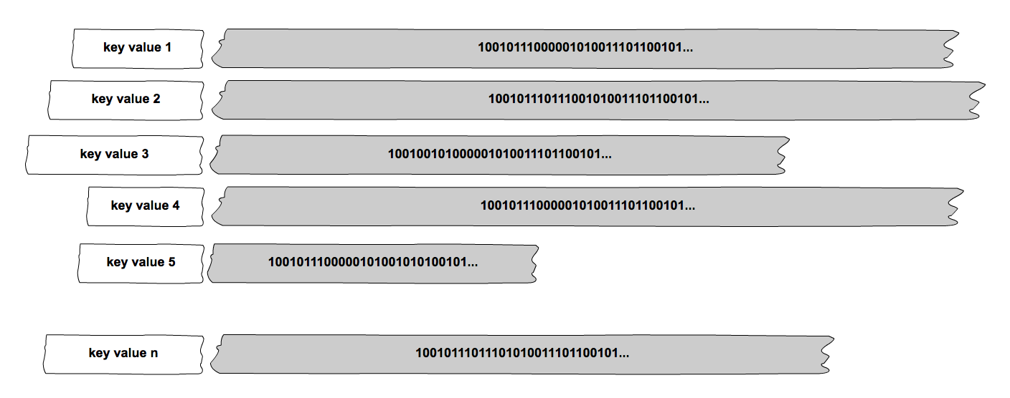

Slide 163
Use Cases for Key-Value Stores
Anything where caching against a key would be beneficial
Session id for web applications
Potentially much faster than an RDBMS and could be in memory
Some hash of user info, though need to beware of clashes
Classic shopping cart info
Can be available across machines/ nodes
Avoids need for session affinity
Eases load balancing
Notes:
Sketch a diagram of a load-balanced web app

Slide 164
NoSQL Data Stores
What is NoSQL
Key Value Stores
Document Stores
Column Stores
Graph Stores

Slide 165
Document Datastores
Commonly used where the data has an internal structure
That would have to be artificially broken up for an RDBMS
MongoDB probably most commonly used
CouchDB
Terrastore
DynamoDB
Notes:
Amazon claim DynamoDB is both document and key-value – makes sense!

Slide 166
Structure of Document Stores
A simple form of datastore
Still a key and a value
Similar to a HashTable in a language like Java
But value is structured
JSON, BSON possibly XML or YAML
Store has knowledge of structure of data
Can query by content
Can retrieve parts of document
Saves machine cycles in application breaking down value

Slide 167
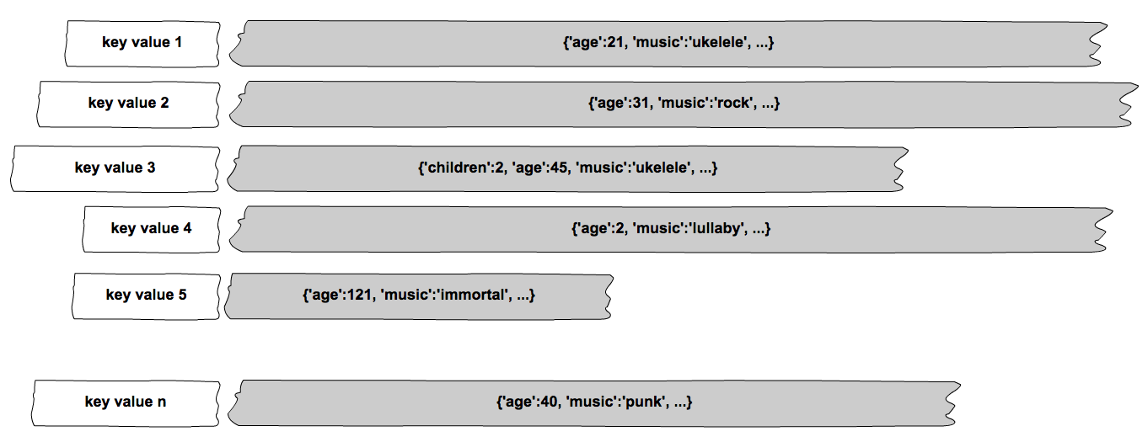

Slide 168
Use Cases for Document Stores
Anything where structure is important
And do not want to break up for RDBMS
Need to keep a flexible schema
'Schema on read'
Anywhere that needs record matching or filtering
Fraud detection systems
End to end transaction matching
Notes:
Mongo DB exercise

Slide 169
NoSQL Data Stores
What is NoSQL
Key Value Stores
Document Stores
Column Stores
Graph Stores

Slide 170
Column Family Datastores
Commonly used where the throughput needs to be high
And data has structure
Cassandra probably most commonly used at time of writing
Others
HBase
Accumulo

Slide 171
Structure of Column Family Stores
Avoids problems caused by rectangular tables in RDBMS
In areas where schema can change
In areas where no data would be common in many RDBMS columns
Saves cost of 'wide' tables and large joins
Column family is structured for retrieval
Need to know the most likely ways that it will be used
Data is "partioned" by an index value
Data has row keys for initial location of data row
Also column key for location of data value
Columns are actually triples
Column key/ column value/ time stamp of update for column
Notes:
Column family is structured for retrieval: clustered indexes – partition values

Slide 172
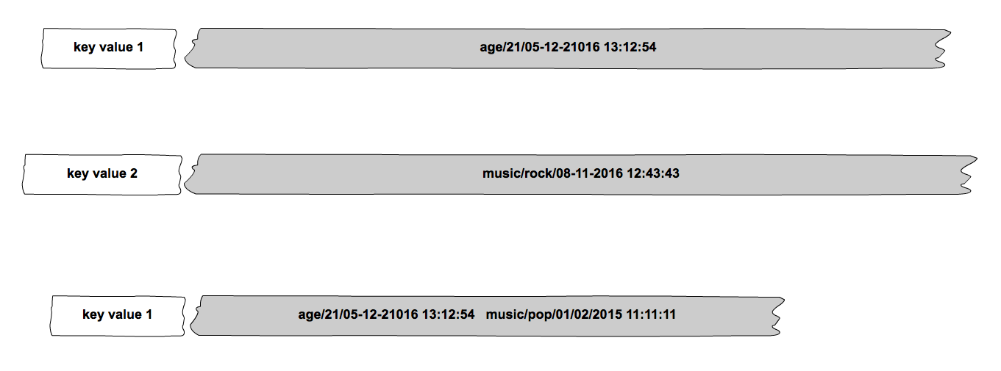
Column Storage

Slide 173
Structure of Column Storage
Keyspace – a bit like a database
Consists of Column Families
Collections of columns
Like RDBMS tables
Column Family
Column Family
Keyspace

Slide 174
Example Column Family
Column Families have multiple rows
Each row has columns
No requirement that each row have the same number of columns
Rob
Bob
Ted
Users

Slide 175

Cassandra
A Practical example of a column data-store
http://cassandra.apache.org/
Highly scalable storage
Apple has a cluster of over 75,000 nodes holding over 10 PB of data
Able to handle very high write volumes
Netflix handles over 1 trillion requests a day
Google claims 1 million writes per second on 330 virtual machines
Even after losing one-third of the cluster
Highly available
Peer-to-peer architecture with no single point of failure
Supports multi–data-center replication of data

Slide 176
Fault Tolerance and Linear Scalability
Cassandra clusters have a peer-to-peer architecture
All the nodes are identical in functionality
No single points of failure
Linear scalability
Write speed of the cluster is directly proportional to the size of your cluster
Netflix has benchmarked over a million writes per second on 288 nodes*
* https://medium.com/netflix-techblog/benchmarking-cassandra-scalability-on-aws-over-a-million-writes-per-second-39f45f066c9e.
Copyright KPL KnowledgeSolutions Ltd – All rights reserved
176
Notes:
<*s*o*u*r*c*e*>*1*2*6*0*c*1*-*1*-*3*0*<*/*s*o*u*r*c*e*>
If you have HBase people in your audience you can compare with HBase which is a master/slave architecture. It therefore has a single point of failure at the master. Hbase needs to use ZooKeeper so that an election can be held when a master fails and a new master selected.

Slide 177

How Cassandra Accesses Data
All data in Cassandra is identified by its partition key
This dictates where it is located in the cluster
The actual node that will store the data
Records in Cassandra are also known as partitions
Partition keys are generated at write time by a hash on the primary key
A program called a partitioner is responsible for hashing a token for a row
Each node is responsible for a range of tokens
Copyright KPL KnowledgeSolutions Ltd – All rights reserved
177
Notes:
<*s*o*u*r*c*e*>*1*2*6*0*c*1*-*3*-*4*<*/*s*o*u*r*c*e*>
RandomPartitioner uses MD5 for the hash
Murmur3Partitioner uses the Murmur3 hash. It is faster than MD5 but is not suitable for cryptography as it can be reversed easily. That is not an issue here. The name is from
MU (mutate) followed by R (rotate) done twice so the version 3 of this hash algorithm is the Murmur3hash. See https://en.wikipedia.org/wiki/MurmurHash

Slide 178
The Cassandra Table
A table contains columns fetched by a key
Partition key is based on the primary key of the table
A table must have a primary key
A column is a triple of the form name/value/timestamp
The partitioner generates a token during the INSERT
CREATE TABLE members (
id int,
name text,
age int,
PRIMARY KEY (id));
INSERT INTO music_recordings
(recording_ID, artist, title, category)
VALUES (1, 'Glen Gould', 'Mozart Piano Concerto', 'Concerto'));
Copyright KPL KnowledgeSolutions Ltd – All rights reserved
178
Notes:
<*s*o*u*r*c*e*>*1*2*6*0*c*1*-*3*-*5*<*/*s*o*u*r*c*e*>
Notice that all nodes of a Cassandra ring must use the same partition algorithm
You can't mix partitioners and you can't change partitioners once you have stored data.

Slide 179
Row Storage
Every column in every row has a timestamp
Generated by Cassandra
Columns of each row are sorted
In ascending order by column name
Partition key
Copyright KPL KnowledgeSolutions Ltd – All rights reserved
179
Notes:
<*s*o*u*r*c*e*>*1*2*6*0*c*1*-*3*-*7*<*/*s*o*u*r*c*e*>

Slide 180
Consistency
Cassandra keyspace (database) should be configured to specify a number of replicas
Replicas are managed automatically
Consistency of replicas is managed per query
ONE, QUORUM, ALL
Writes
Success is reported to client in one, the majority or all replicas report success
Reads
Data fetched from a single node
Fetches and checks digests of other replicas based on consistency setting
Digest mismatches indicate replication failure
Will automatically repair based on timestamp values
Copyright KPL KnowledgeSolutions Ltd – All rights reserved
180

Slide 181

Use Cases for Column Family Stores
Commonly used in data / event logging systems
Financial transactions
Web analytics
Notes:
Cassandra Exercise

Slide 182
NoSQL Data Stores
What is NoSQL
Key Value Stores
Document Stores
Column Stores
Graph Stores

Slide 183
Graph Datastores
Used where the interest is in the relationships
As well as the data itself
Many available
In the Java world probably most common is Neo4J
Flock
Infinite Graph

Slide 184
Structure of Graph Stores
Data is stored as a collection of nodes and relationships
Nodes can be structured data, as can the relationship
Underlying processes rely on graph theory
The nodes represent 'items or 'entities'
For example a cricket team
Has a set of properties to hold data
Can be grouped into sets
Relationships connects the nodes
Allows traversal
Gives some structure to the graph overall

Slide 185
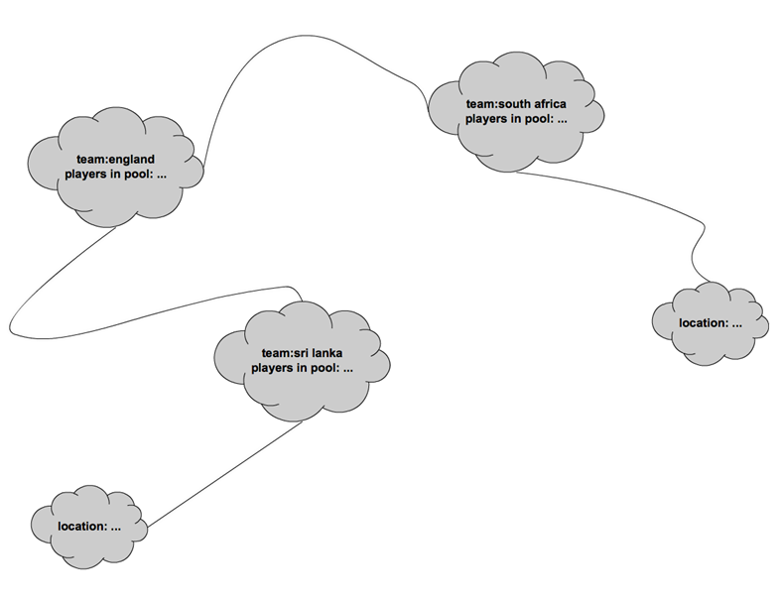

Slide 186
Use Cases for Graph Stores
Very commonly used in recommendation engines
"Neighbourhoods" can be created by traversing relationships
Anywhere a query is based on the relationship between data
Shortest journey type questions
Notes:
Use the Neo4J online demo

Slide 187
Datastores
Working from the system explained to you
Which datastores would be of use?
Where?
Why did you pick those one(s)?
Notes:
If we are ahead of schedule then get them to incorporate one of the DB's into a service solution

Slide 188
Session Summary
In this session we have examined
The concept of a NoSQL datastore
Key value data stores
Document stores
Column stores
Graph stores
188

Slide 189
Chapter 8: Container Orchestration

Slide 190
Session Objectives
In this session we will examine
Composing multiple containers to deploy a service
Using Docker Swarm to manage scalable deployment
190

Slide 191
Container Orchestration
Docker Networks
Docker Compose
Docker Swarm

Slide 192
Docker Networks
Docker defines 3 standard networks
bridge, host, none
Bridge – the default
All containers my communicate with each other via IP
Host
Containers share the host network address
From a network standpoint, they are not isolated from the host
None
Containers are in their own private network
Communication only possible via exposed ports
Specify the network to attach to with –-network=<NETWORK> argument to docker run
192

Slide 193
Custom Networks
Custom networks may also be created
docker network create --driver bridge isolated_nw
Allows groups of machines to work together
Isolated from others
Docker also created overlay networks in Swarm mode
Allows machines on different hosts to communicate
193

Slide 194
Exposing and Publish
Machines within a Docker network are not visible outside the network
Unless
Ports are EXPOSED in the Dockerfile
And published when the container is run
FROM node:6-onbuild
EXPOSE 8090
docker run –p: 8090:8090 –d image
Host port
Container port
194

Slide 195
Container Orchestration
Docker Networks
Docker Compose
Docker Swarm

Slide 196
Docker Compose
Docker compose is a tool for running multi-container Docker applications
A configuration file is used to define the services
All of the services can be run using a single command
Compose can manage the lifecycle of an application
Start stop and rebuild services
Get the log output of running services

Slide 197
Features
Supports simultaneous operation of multiple environments on a single host
Each compose project is isolated from all others
Automatically preserves data written to volumes
Efficiently reuses old containers
When you start a composition, it will detect containers from a previous run and reuse them
Compositions may be deployed to
A single host
For testing
A Swarm
For production
197

Slide 198
Running Compose
Create a directory for Docker Compose
Create a YAML file called docker-compose.yml
The docker-compose command needs to be run from the directory containing the YAML file
Docker Compose has an up option which runs all containers
The down option terminates all managed containers
Many other command line options including scaling commands
https://docs.docker.com/compose/reference/

Slide 199
Skeleton docker-compose.yml
version: '3'
services:
db:
image: subs-mongo
ports:
- "27017:27017"
dbinit:
image: subs-mongo-init
depends_on:
- "db"
web:
image: subs-wildfly
ports:
- "8081:8080"
Docker Compose version
Service definition
Docker image name
Container dependency
Ports to publish
199

Slide 200
Compose Network Configuration
Each service is a single container
Service name becomes a host name
Visible to all containers on the same network within the composition
version: "3"
services:
web:
image: username/repository:tag
deploy:
ports:
- "80:80"
networks:
- servicenet
networks:
servicenet:
Host name
Network Attachment
Network Declaration
200

Slide 201
Data Volumes
Persistent data should be stored in a volume
Saved on the host
Preserved when the container is stopped
Volumes may be specified in the docker-compose file
volumes:
# Just specify a path and let the Engine create a volume
- /var/mydata
# Specify an absolute path mapping
- /opt/mydata:/var/mydata
201

Slide 202
Docker Compose Reference
Compose configuration reference:
https://docs.docker.com/compose/compose-file/
202

Slide 203
Docker Compose Demo / Exercise
This will be a live demo (or an exercise if time permits) of how to create, run and interact with a Docker Compose set of machines for the exercises
Notes:
Docker Compose EX

Slide 204
Container Orchestration
Docker Networks
Docker Compose
Docker Swarm

Slide 205
Docker Swarm – What is it?
Docker Swarm is clustering for Docker
It turns several Docker hosts into a single virtual Docker host
The Swarm is controlled by a Swarm Manager
Each Docker node communicates with the manager
A machine needs to be designated as a manager
There can be several managers
The manager is created by initialising a Swarm
It must be performed on the manager machine

Slide 206
Swarm Services
A Docker Service is a container
Services run in Docker Swarm
They can only be started on a Swarm Manager node
Multiple copies of services can be run
The Swarm Manager replicates the service on other nodes in the Swarm
A service can be scaled
The service will be duplicated and run on different nodes

Slide 207
Docker Swarm on AWS
Amazon Web Services provide a template for creating a Swarm
Can be managed through a Docker Cloud account
Steps:
Create a Docker Cloud account
Create an AWS account
Create an account role to allow Docker Cloud to access AWS
Create a Swarm through Docker Cloud
Resources are automatically created on AWS
Connect to the Swarm and deploy services
207

Slide 208
Swarm on AWS Creates Resources
Creating a Swarm on AWS creates a lot of resources
Many chargeable
Terminating the Swarm destroys the resources
The created (chargeable) resources include
Load balancer
Auto-scaling Groups
Running Instances
Dynamo DB table
208

Slide 209
Docker Swarm Demo
Your instructor will demonstrate how to create, run and interact with a Docker Swarm

Slide 210
Session Summary
In this session we have examined
Composing multiple containers to deploy a service
Using Docker Swarm to manage scalable deployment
210

Slide 211
Chapter 9: SAM and Reactive Systems

Slide 212
Session Objectives
In this session we will examine
Reactive code
Server less solutions
212

Slide 213
SAM and Reactive systems
Modern systems are increasingly being written to react
They await an event, check a condition evoke an action
Requires
A mechanism to generate the trigger condition
Often some form of Monitoring
A service to respond to the trigger
AWS Serverless Application Model (SAM)
Allows discrete code to be activated in response to a trigger
Known as a Lambda
Lambdas are not unique to AWS
Available as part of the codebase in many languages
Java 8, Scala, ECMAScript 6 etc.
AWS Lambdas are not constrained by programming language capabilities
They are scripts invoked by a trigger condition

Slide 214

AWS Lambdas
Code with no server!
Not really – of course
How AWS Lambdas work
You provide the code to execute
You define the trigger conditions
When the trigger occurs
The code runs
You pay for the execution
214

Slide 215
AWS Lambda Functions
May be written in
JavaScript – NodeJS
Java
Python
C#
Full documentation
http://docs.aws.amazon.com/lambda/latest/dg/lambda-introduction-function.html
215

Slide 216
Lambda code example
Hello World Lambda for NodeJS runtime
Detail of the event that triggered the lambda
Information about the AWS environment
exports.handler = (event, context, callback) => {
// TODO implement
callback(null, 'Hello from Lambda');
};
Error
The function to invoke to generate a response
Result
216

Slide 217
Processing Received Data
Data is passed into a Lambda in the event
Content will depend on how the Lambda was triggered
If triggered via the API Gateway (as a REST service)
event.httpMethod – GET / POST / PUT etc
event.body = The body of the HTTP request
event.queryStringParameters = Query string arguments
EG event.queryStringParameters.memberName
event.path the request string
217

Slide 218
Example Lambda – API Gateway
exports.handler = (event, context, callback) => {
//console.log('Received event:', JSON.stringify(event, null, 2));
const done = (err, res) => callback(null, {
statusCode: err ? '400' : '200',
body: err ? err.message : JSON.stringify(res),
headers: {
'Content-Type': 'application/json',
},
});
switch (event.httpMethod) {
case 'DELETE':
dynamo.deleteItem(JSON.parse(event.body), done);
break;
case 'GET':
dynamo.scan({ TableName: event.queryStringParameters.TableName }, done);
break;
}
};
218

Slide 219
Triggering Lambdas
AWS Lambdas may be triggered from several sources
API Gateway
AWS IoT
Alexa tools
CloudWatch
S3
SNS
Many more
API Gateway allows association of a REST API
Defined using OpenAPI
With a Lambda function
219

Slide 220

REST Service with API Gateway and Lambda
Trigger
REST
Callback Return Value
API Gateway
Lambda
220

Slide 221
AWS Lambdas
Your instructor will demonstrate the capabilities of AWS Lambdas
Notes:
This will be a live coding session on how to use the various types of reactive code available to us. This will include a mix of AWS Lambdas and AWS SNS to react to, and notify of, several scenarios.
The plan:
Create a simple Lambda
Associate with a Gateway
Invoke the gateway
Examine the output

Slide 222
Session Objectives
In this session we have examined
Reactive code
Server less solutions
222

Slide 223
Chapter 10: Course Summary

Slide 224
Closing Thoughts
When should microservices be used?
(What problems do they solve)
When should microservices NOT be used?
224

Slide 225
Course Summary
In this course we have:
Examined the challenges of distributed systems
Identified the suitability of Microservices
Applied design patterns to Microservice architecture
Evaluated NoSQL database models
Simplified service deployment with containerisation
Explored server less services

